Slide 1
Project INSPARK........
-Excalibur-Bank Management System

Slide 2
TEAM MEMBER
Pranjal Prateek 1NT18IS114
Rishabh Kumar 1NT18IS124
Suyash Agrawal 1NT18IS168
Sarad Chhetri 1NT18IS200

Slide 3
AIM
To develop a software for solving financial applications of a customer in banking environment in order to nurture the needs of an end banking user by providing various ways to perform banking tasks. Also to enable the user’s workspace to have additional functionalities which are not provided under a conventional banking software.

Slide 4
Problem Description
The bank management system is an application for maintaining a person’s account in a bank. The system provides the access to the customer to create an account, deposit/withdraw the cash from his account, also to view reports of all accounts present. The following presentation provides the specification for the system.

Slide 5
Functions
Administrator And Staff Login/Logout.
Add/Delete Users (Staff).
Open New Accounts.
Cash Deposit, Withdrawal, Fund Transfer.
Check Balance, Account Details.

Slide 6
Conclusion
This project is developed to nurture the needs of a user in a banking sector by embedding all the tasks of transactions taking place in a bank.
Future version of this software will still be much enhanced than the current version. Thus the Bank Management System it is developed and executed successfully.

Slide 7
Snapshots

Slide 8
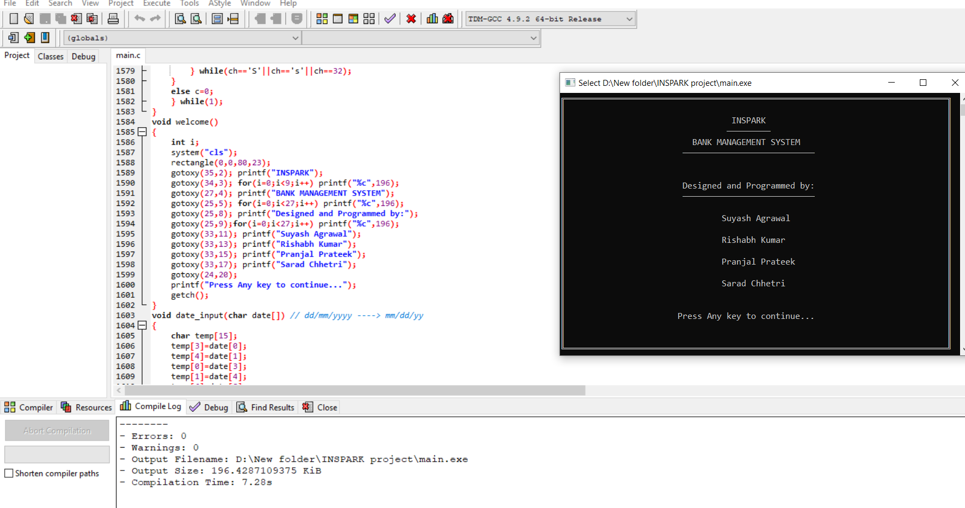

Slide 9
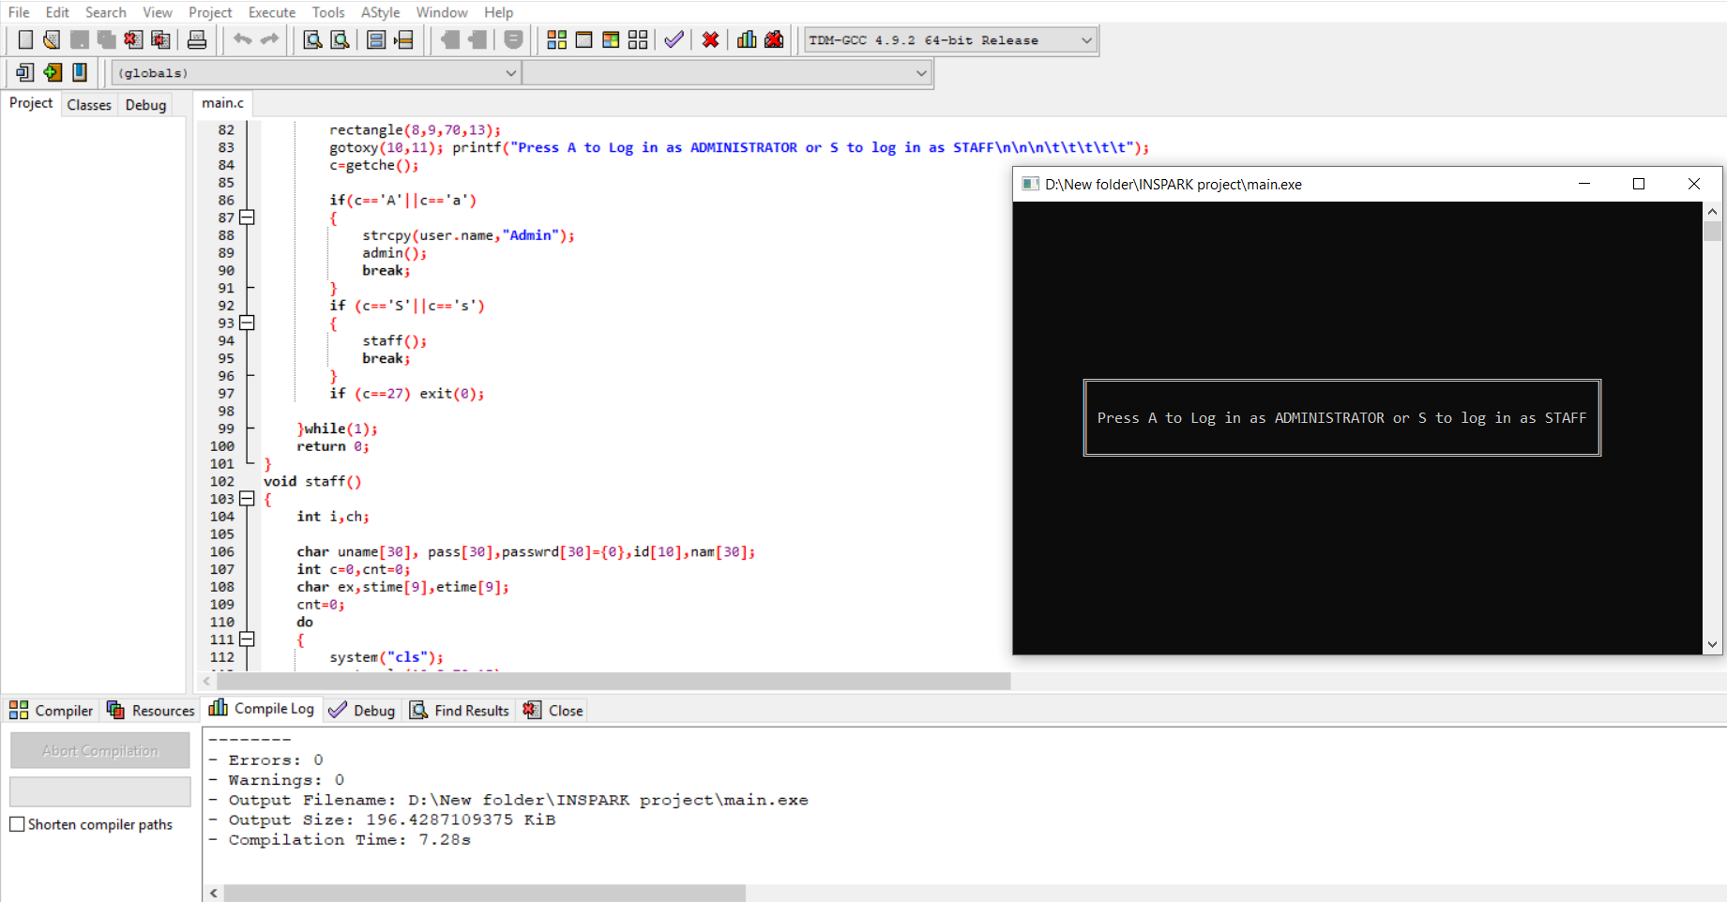

Slide 10
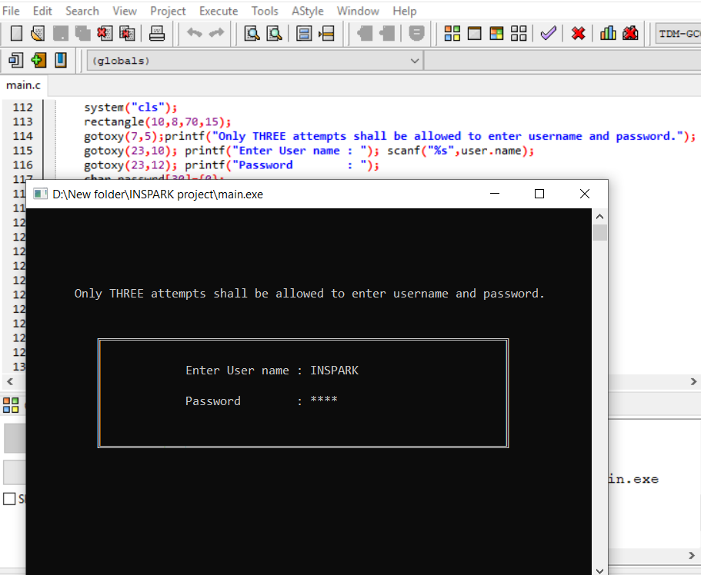
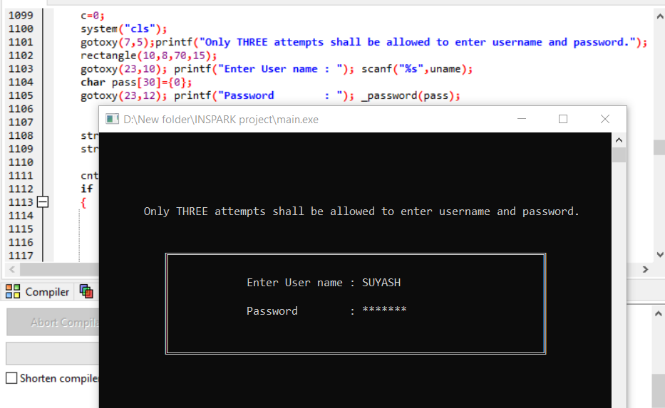

Slide 11
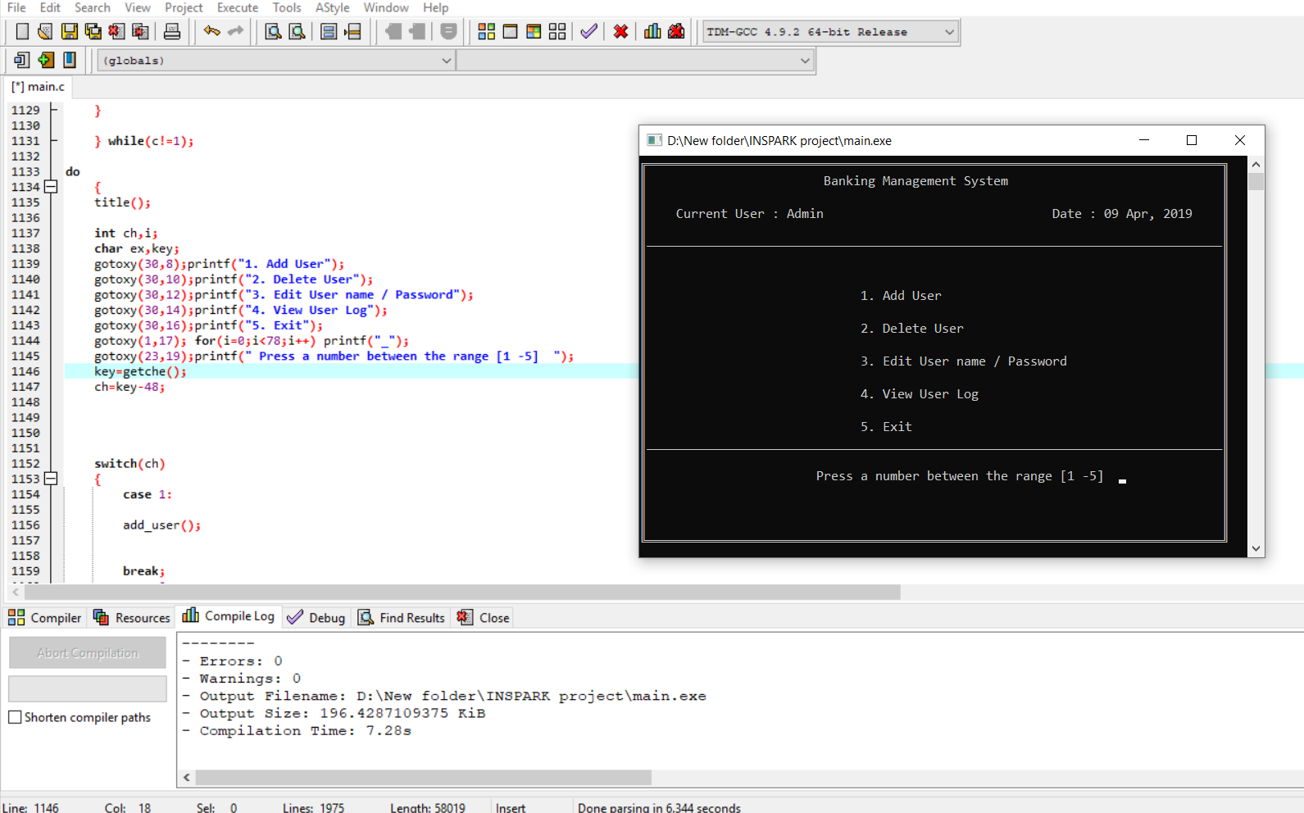

Slide 12
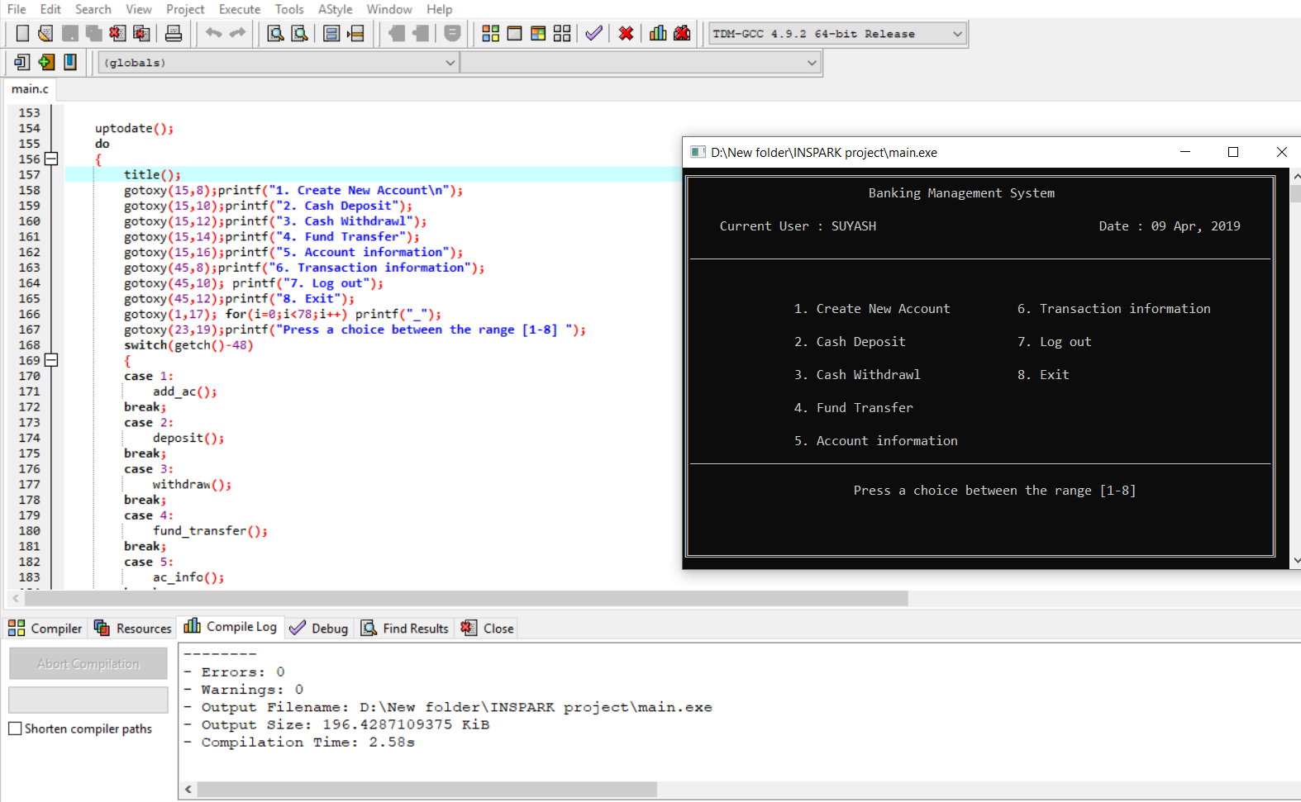

Slide 13
Future Look
More branches of the bank, maybe it will be international.
Customer issues development based on their needs, so the help desk will be aware of their needs and easy to use.
Developing a mobile app for banking system that help user to do his/her operations without going to the bank, the user only needs to sign in using his/her A/C number, and password and then set your own pin. Finally the system will update automatically.

Slide 14
Thank You…

